Slide 1
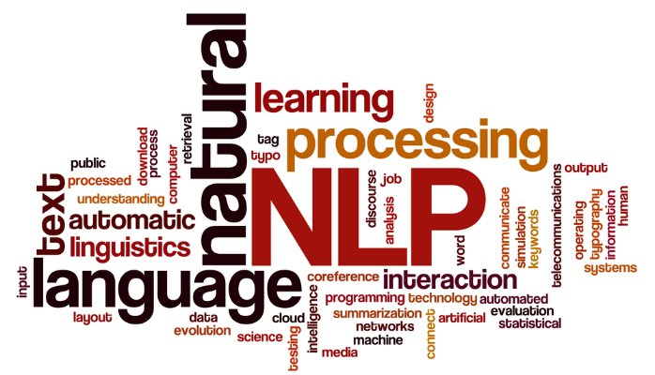
NLP (Natural Language Processing) 101
Dan Ofer ddofer@gmail.com

Slide 2
who am I?
(Dan)

Slide 3


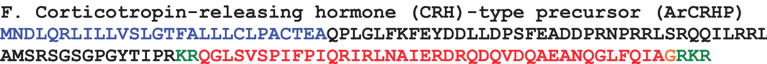
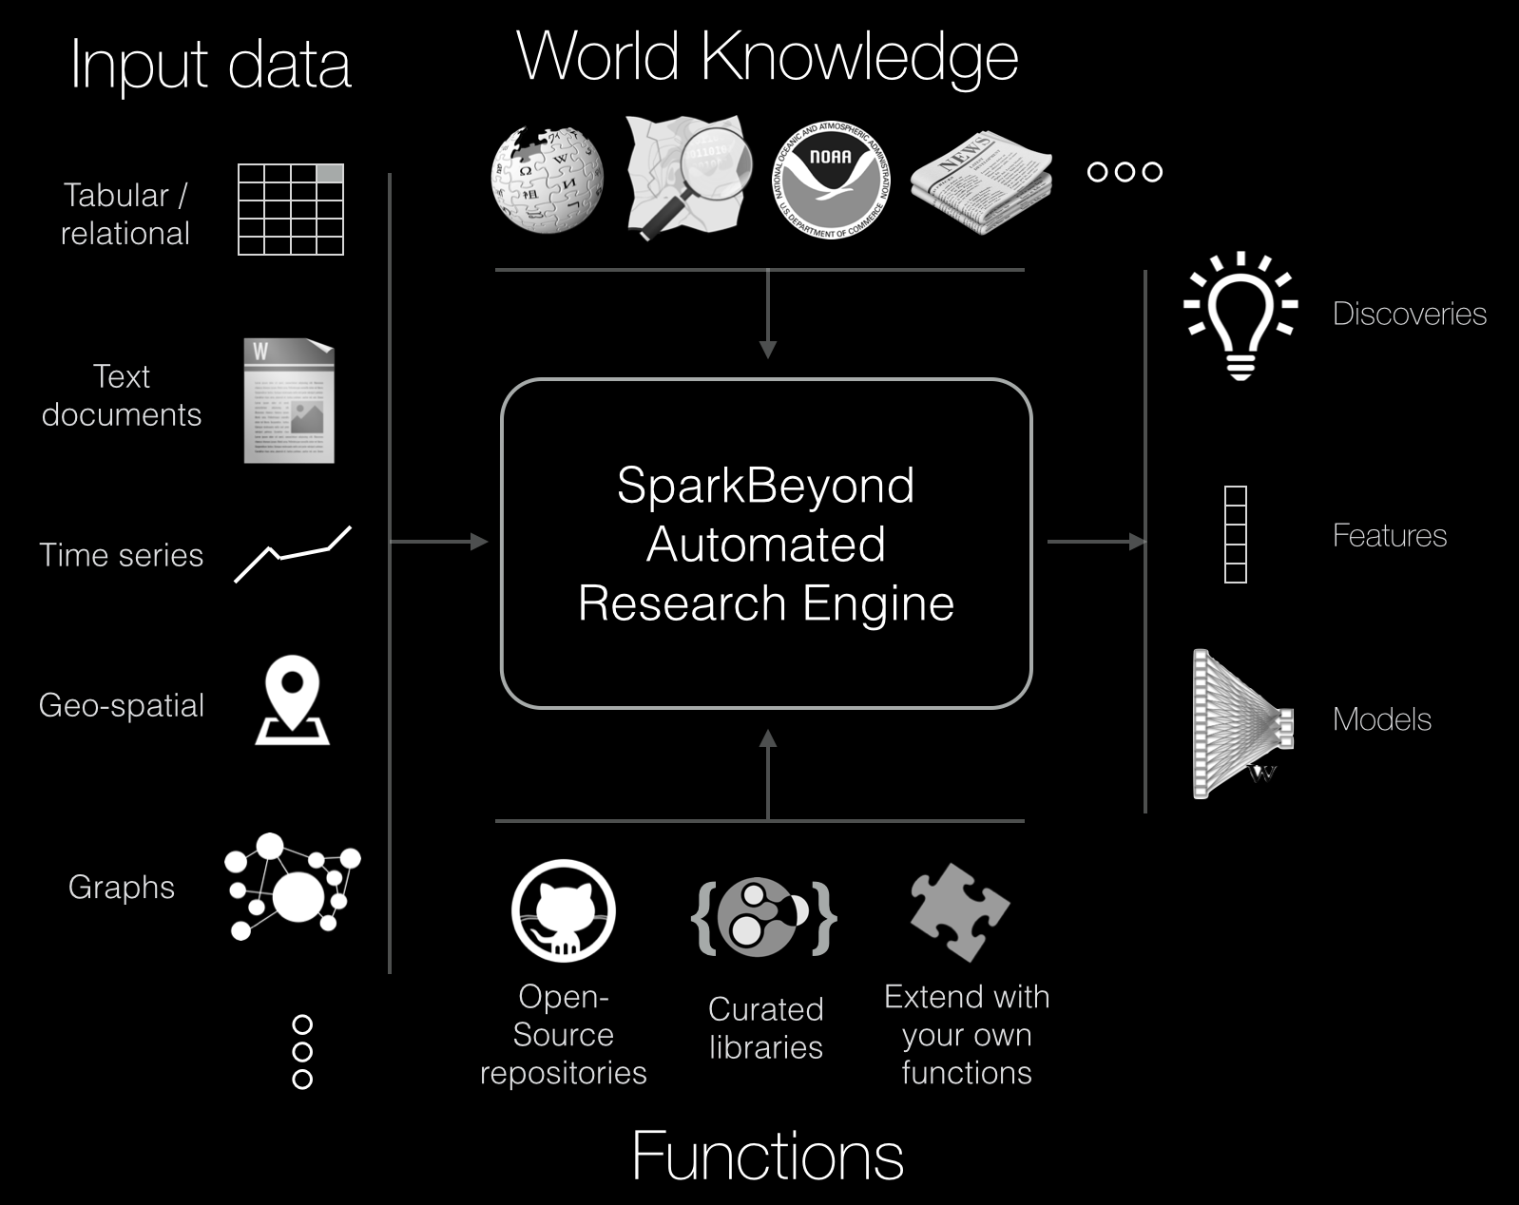
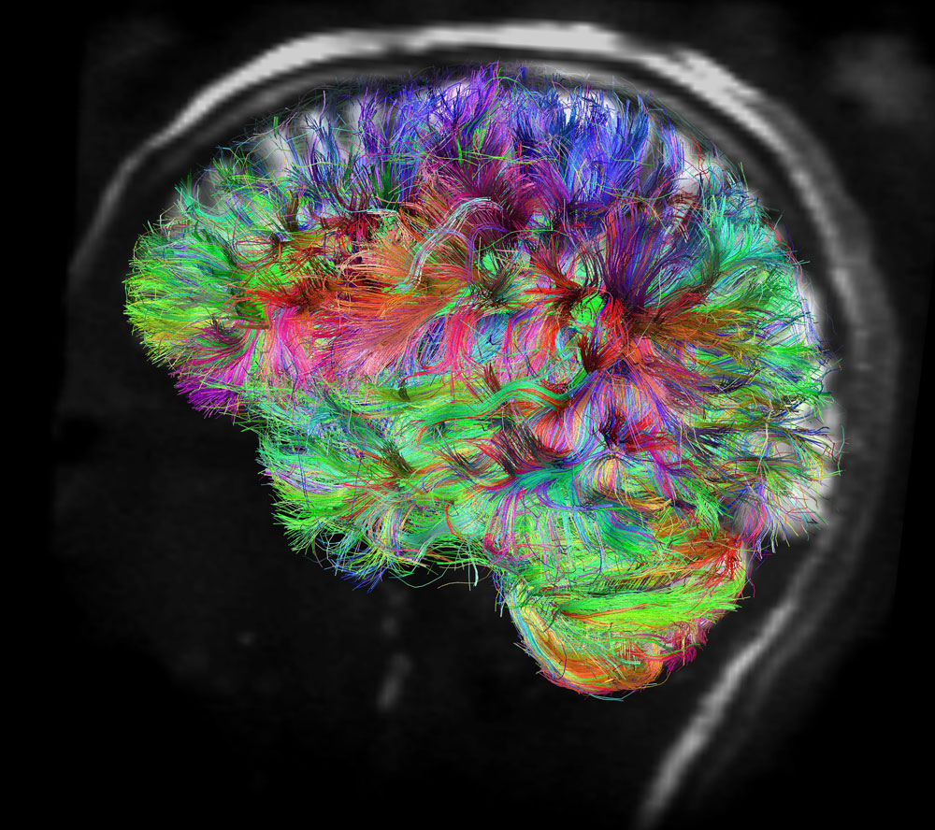
Dan Ofer
Data Scientist @ SparkBeyond
MsC: Neuroscience & Bioinformatics
HUJI @ M. Linial: Neuropeptides & Protein feature engineering.
BsC: Psychobiology
Army: Translation = תרגום
dan@sparkbeyond.com

Slide 4

Natural Language Processing <=> Computer Science + AI + Computational Linguistics
NLP systems: “understand” natural (i.e unstructured) language in order to infer intent/tasks.

Slide 5
why 1S nlp 50 h4rd
Ambiguity
Unstructured (relatively)

Slide 6

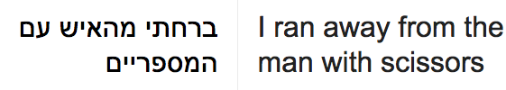
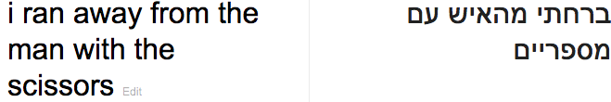

Slide 7
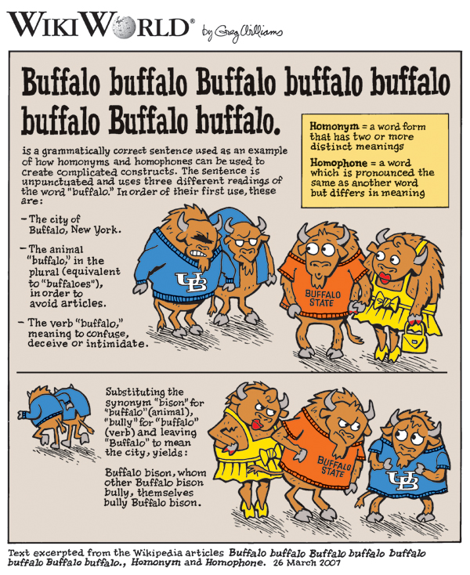
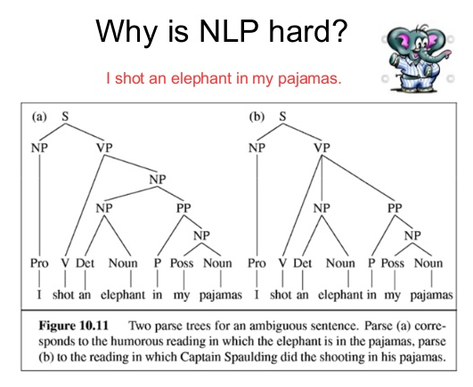

Slide 8
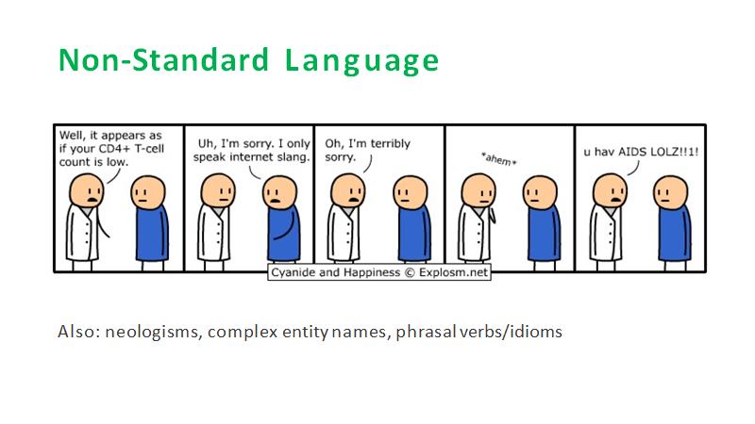
Notes:
Neologism = a newly coined word or expression.
Phrasal Verb = verb + adverb or verb + preposition , with a different meaning than the original. E.g. I ran into my teacher at the movies last night. run + into = meet. He ran away when he was 15.

Slide 9
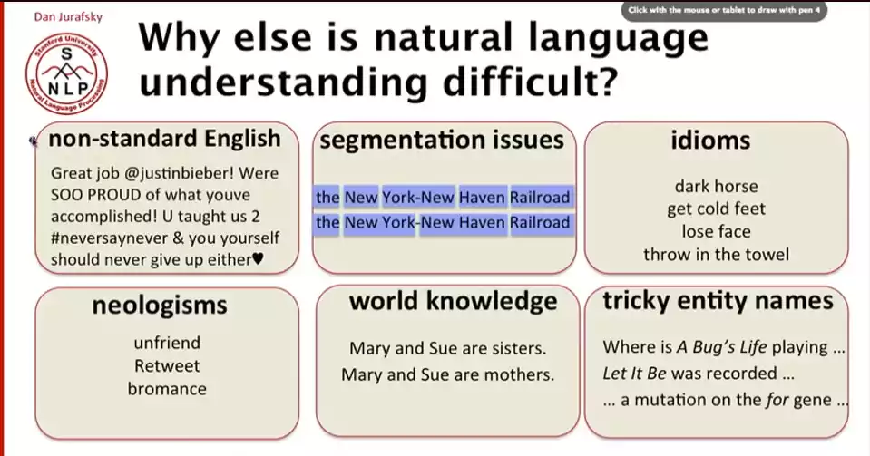

Slide 10
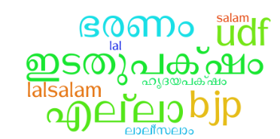
English is easy..
• German: Donaudampfschiffahrtsgesellschaftskapitän (5 “words”)
• Chinese: 50,000 different characters.
• Japanese: 3 writing systems
• Thai: Ambiguous word boundaries and sentence concepts
• Slavic: Different word forms depending on gender, case
Hebrew: ambiguous Roots (e.g. שלם), lots more..
Notes:
E.g. for Hebrew:
http://www.code972.com/blog/2010/05/18-challenges-with-indexing-hebrew-texts-hebmorph-part-1
https://en.wikipedia.org/wiki/%C5%A0-L-M

Slide 11
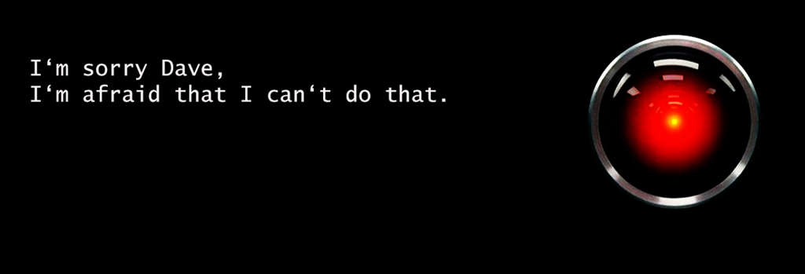
What can NLP do?

Slide 12
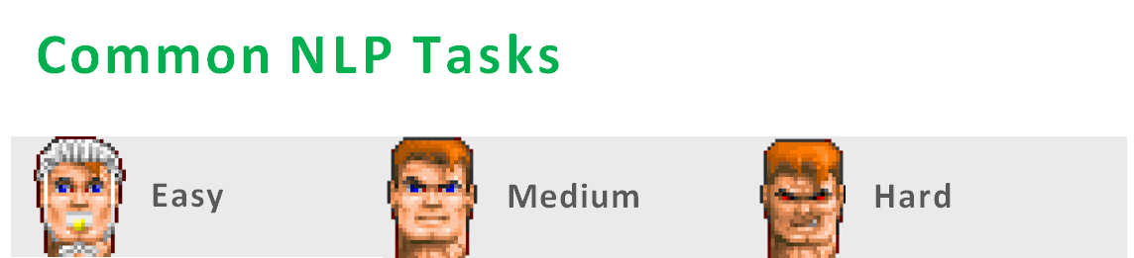
• Tokenization
Predict Word-level Labels/class
• Part-of-Speech Tagging. (Verb, noun, adjective…)
• Named Entity Recognition (NER)
•Predict a text’s class
Sentiment Analysis
• Syntactic (syntax) Parsing
•Word Sense Disambiguation
• Topic Modeling (LDA)
Audio-> Text..
Machine Translation
• Text Generation
• Summarization
• Question Answering
•Conversational Interfaces
Understanding. (Grade essays)
Notes:
Word Sense D = identifying which sense of a word (i.e. meaning) is used in a sentence, when the word has multiple meanings.
S y n t a x: provides rules to put together words to form components of sentence and to put together these components to form sentences. Plural - syntactic rules

Slide 13
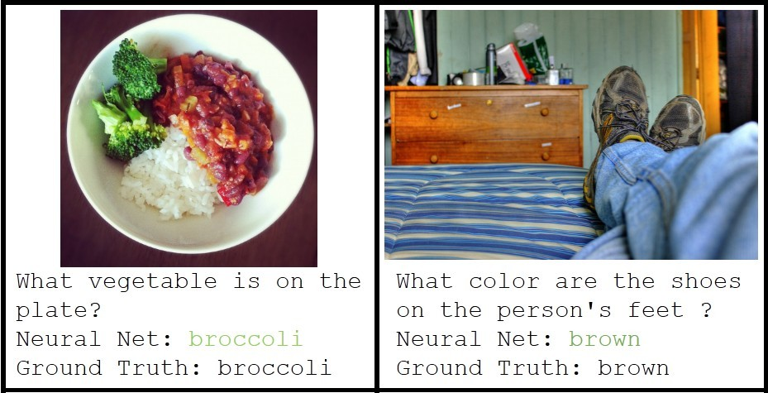
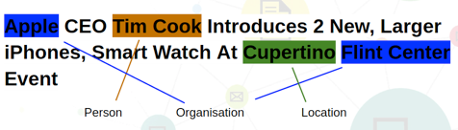
NLP ‘annotations’/tasks
Question Answering
Siri: ‘When does Shabat end?’
Sentiment Analysis.
‘The movie was great, in the same way the Matrix sequels were.’
‘Help help help!!!’
Image to Text Mappings (Generating descriptions/captions for images)
Named Entity Recognition (NER)

Slide 14
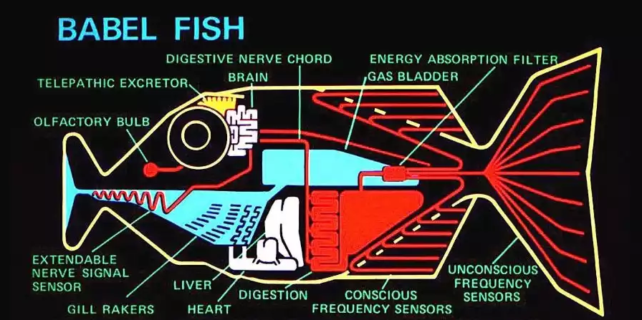
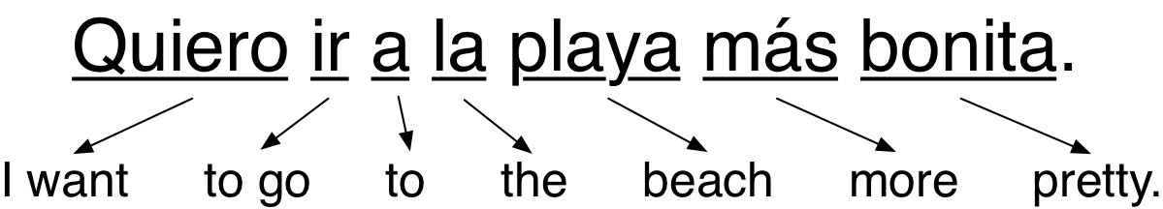
Translation
Notes:
https://medium.com/@ageitgey/machine-learning-is-fun-part-5-language-translation-with-deep-learning-and-the-magic-of-sequences-2ace0acca0aa#.gqcp3ylax

Slide 15
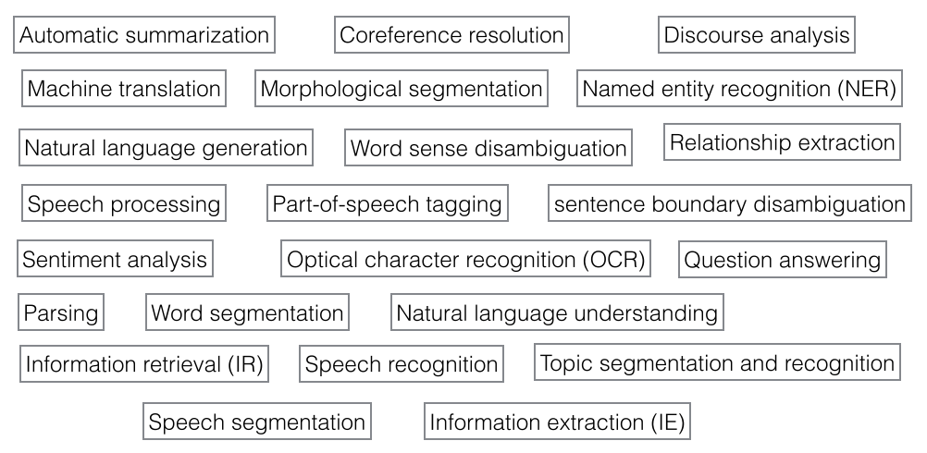
Many more uses...

Slide 16
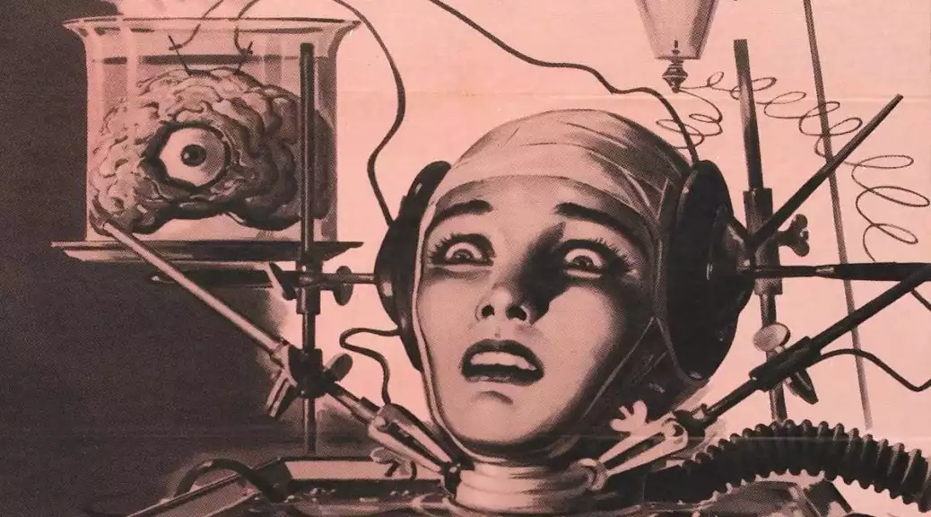
ML, NLP & You: Feature Engineering
Notes:
Let’s say you want to classify a text tommorow: how to start

Slide 17
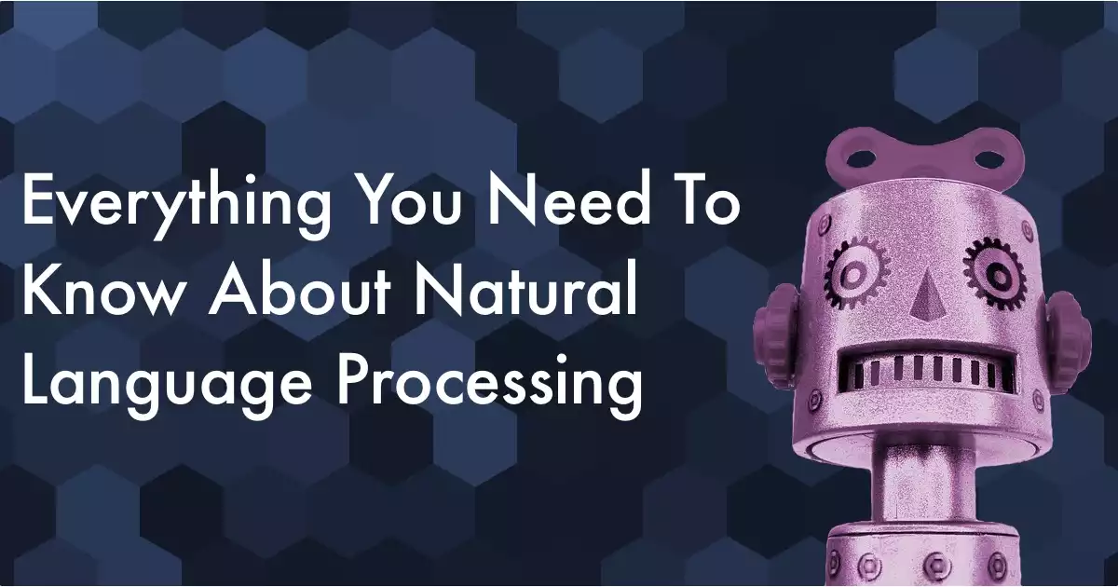
Getting started in NLP & ML
Basics First. Deep Recursive, Recurrent network with POS vectors & knowledge ontologies later.
Bag of Words + preprocessing = can do a LOT, fast!
Good libraries to know: Gensim, spaCy, CoreNLP, TextBlob, NLTK, Polyglot, Textacy, tm (R)..
Can have many components, can be building blocks or tasks themselves..

Slide 18
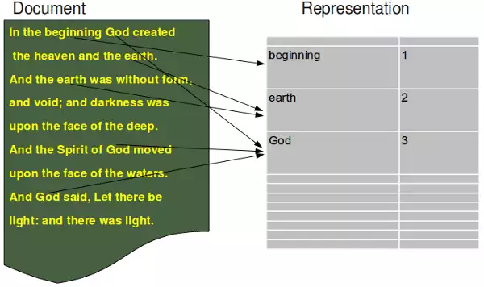
The Classic: Bag of Words (BOW)
Count the Words!
Sparse, one-hot encoded vector
Dimension = vocab size
Preprocessing crucial!:
Tokenize
Stem
Lemmatize
Stop-words removal
...
Notes:
Stop words: “and, he, if, or the”
Zipf law

Slide 19
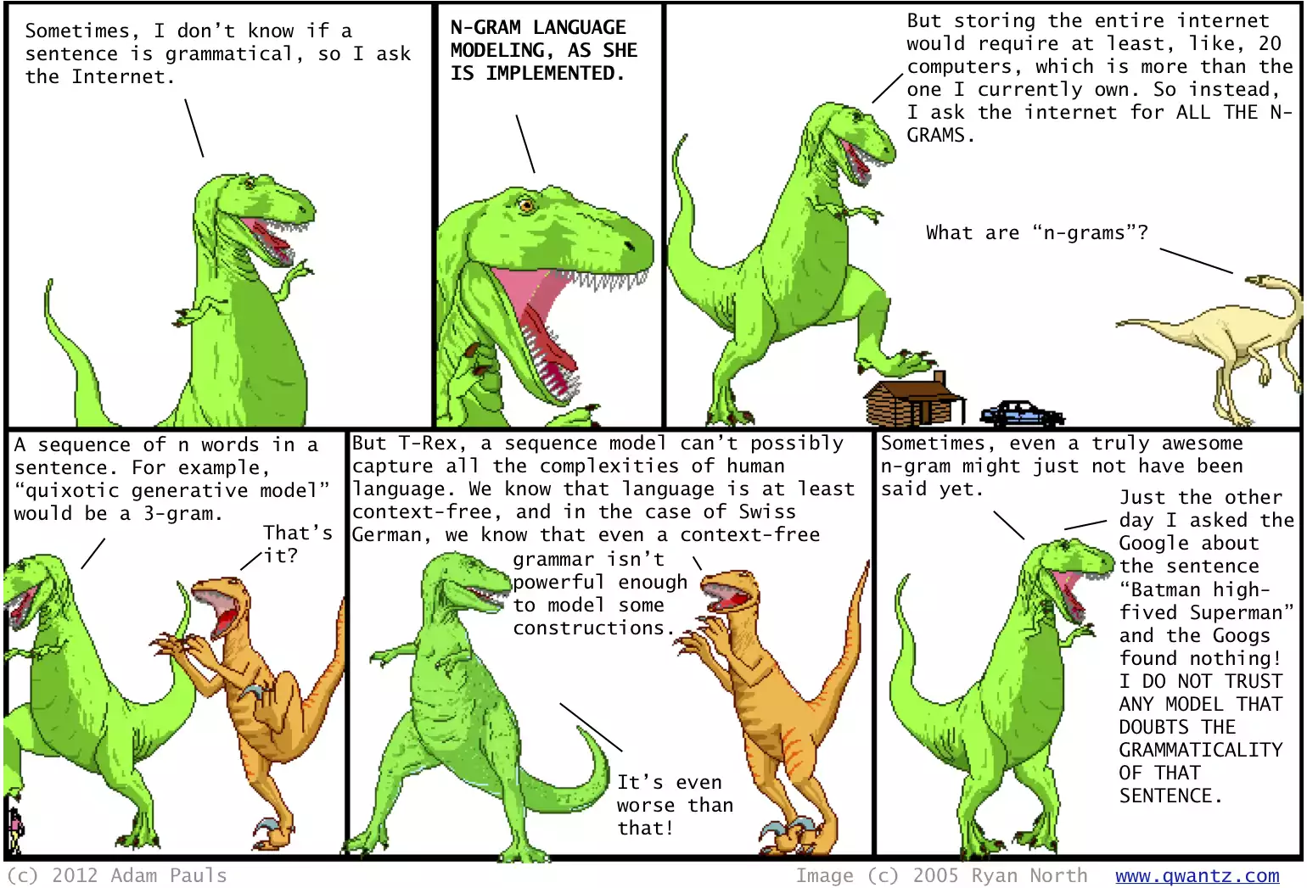
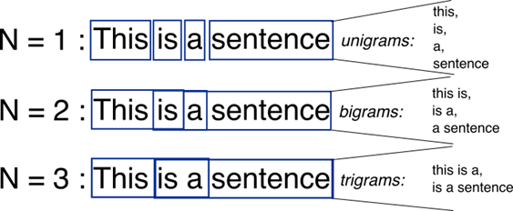
n-grams
Gets big FAST.
BONUS: K-mers, skipgrams..

Slide 20
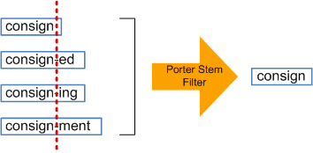
Basics of Preprocessing: Extract, tokenize, Stem, Lemmatize...
Stem:
“Chop off the end”. Rule based.
Lemmatize: ‘Basic form/meaning of the word in the dictionary’
Eat = Consume. Feebleminded = retarded…
run, runs, ran, running -> run
Requires dictionary (e.g. WordNet) & POS tags
”Produced":
lemma ="produce".
Stem ="produc-".
Notes:
Stem is the part of the word that never changes even when morphologically inflected; a lemma is the base form of the word.
http://textanalysisonline.com/spacy-word-lemmatize
https://nicschrading.com/project/Intro-to-NLP-with-spaCy/
http://stackoverflow.com/questions/38763007/how-to-use-spacy-lemmatizer-to-get-a-word-into-basic-form

Slide 21
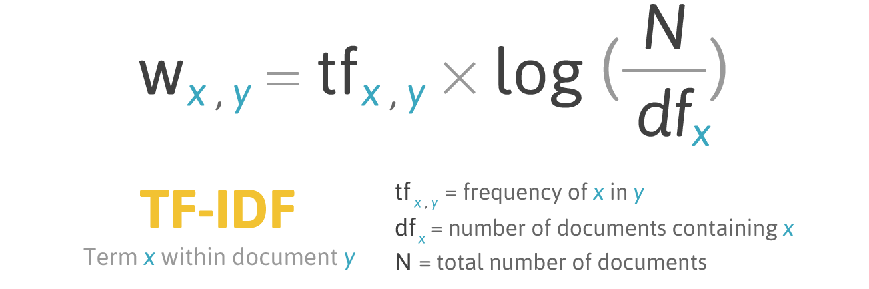
Getting started in NLP ML: The Classic TF
TF, TF-IDF: term frequency–inverse document frequency.
Top method in information retrieval!
Fast, effective.
Still loses word-ordering.
IDF: ‘Unique’/informative words = better than simply common words.
Notes:
TF-IDF : a numerical statistic that is intended to reflect how important a word is to a document in a collection or corpus. There’s usually also a smoothing factor. Applies also to ngrams.

Slide 22
TF-IDF Simpsons’ Summaries
Episode title | tf–idf summary
Bart the Genius | kwyjibo
Homer's Odyssey | nuclear energy
Bart the General | sound off
The Telltale Head | jebediah
Krusty Gets Busted | krusty
Bart Gets an "F" | blah blah blah blah
Simpson and Delilah Treehouse of Horror Last Exit to Springfield | Dimoxinil Nevermore Dental Plan
Notes:
Source: http://toddwschneider.com/posts/the-simpsons-by-the-data/
Deep learning: https://research.googleblog.com/2016/08/text-summarization-with-tensorflow.html

Slide 23


Slide 24
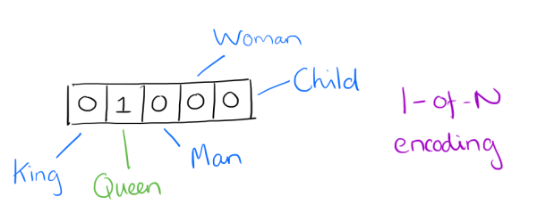
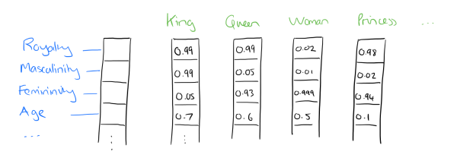
Distributed Word Embeddings AKA Word2Vec
OHE/ Bag of words model is very high-dimensional, sparse, doesn’t naturally capture similarities.
Idea: represent words as dense vectors
[0 1 0 0 0 0 0 0 0] [0.315 0.136 0.831]
Many algorithms: Word2Vec, GloVe, FastText, WordRank, etc’
Effective even without DL models, Seq2seq, LSTMs, etc’
Notes:
Image: https://blog.acolyer.org/2016/04/21/the-amazing-power-of-word-vectors/

Slide 25
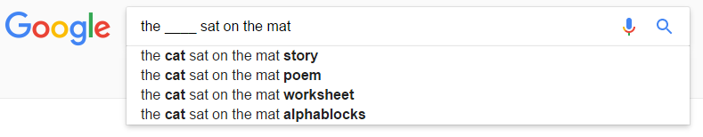
Word Vectors: The Big Idea
The ____ sat on the mat
Cat? Dog?
Entomophagy (eating of insects by people)?
Supercalifragilisticexpialidocious?
Suoicodilaipxecitsiligarfilacrepus ?

Slide 26
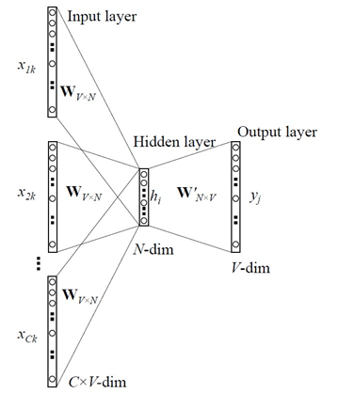
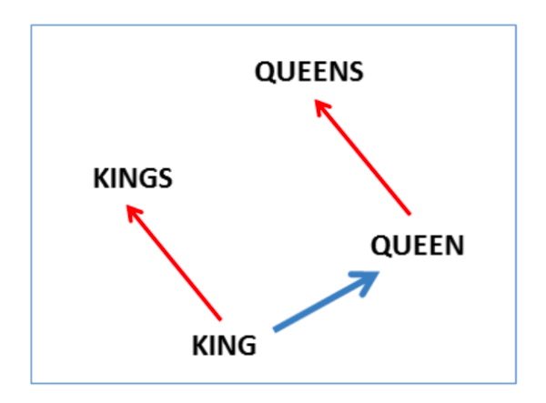
Word2Vec Embedding:
CBOW: Predict center word given context (Surrounding words).
Skip-gram version: predict context from center word
W2V tricks: Negative subsampling, speed (Shallow), # data, phrase coallocation..
Notes:
The training objective is to maximize the conditional probability of observing the actual output word (the focus word) given the input context words, with regard to the weights.
https://blog.acolyer.org/2016/06/01/distributed-representations-of-sentences-and-documents/

Slide 27
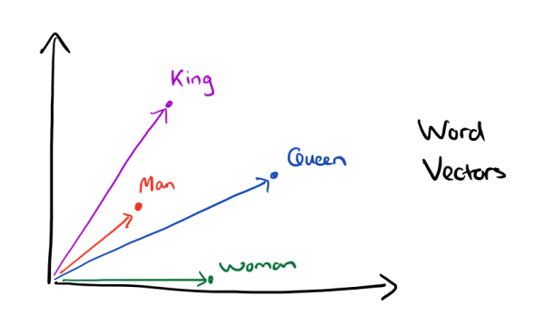
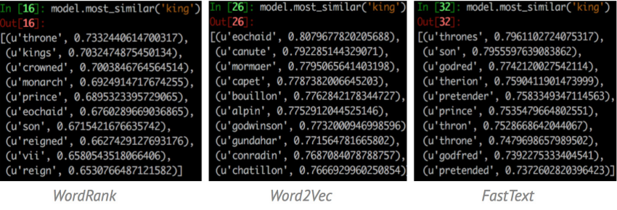
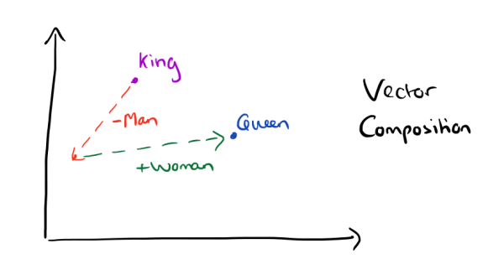
Notes:
Top image: The morning paper: https://blog.acolyer.org/2016/04/21/the-amazing-power-of-word-vectors/
Bottom image: https://rare-technologies.com/wordrank-embedding-crowned-is-most-similar-to-king-not-word2vecs-canute/

Slide 28
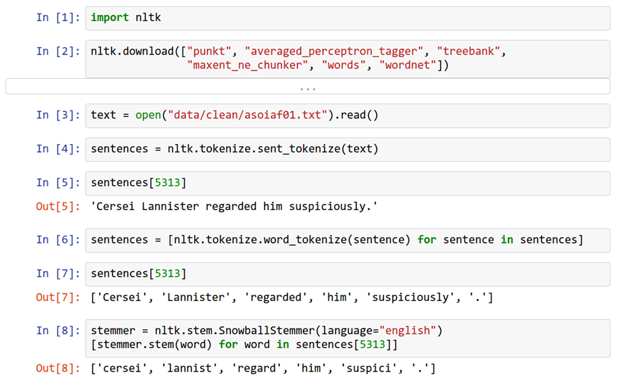
Tokenization & Stemming

Slide 29
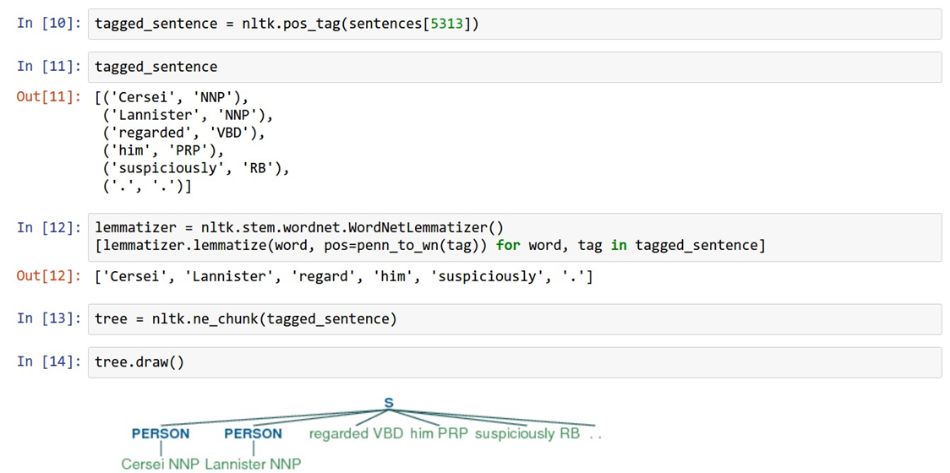
POS/NER Tagging

Slide 30
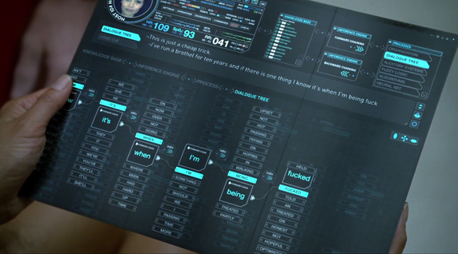
Text Generation
“Jane hit June and then she [fell/ran].”
Old days: Markov. Today: LSTM (RNNs).
Character level VS Word level models.
Not just words: music, etc’.
Karpathy: The Unreasonable Effectiveness of Recurrent Neural Networks
HPMOR: https://www.facebook.com/notes/dan-ofer/harry-potter-char-rnn/10154441648502719

Slide 31

The End!
תודה רבה! Toda Raba!

